Slide 1
DEVELOP AN OUTCOME L2
Evidence of Learning Template
YOUR NSN NUMBER HERE
Project Title : Fantasy Football Quiz

Slide 2
https://trello.com/b/Qq0Unc8p/project-management
You MUST provide evidence showing how the problem has been decomposed, how the components have been developed and trialled, and of how they have been assembled and tested to create a final, working outcome.

Slide 3
Project management: Setup
Record evidence that you have setup project management tools to manage the development of your outcome.
Record evidence that you have chosen project management techniques to manage the development of your outcome.
Record evidence that you have setup/ chosen version control tools/techniques to manage the development of your outcome.
Explain why you believe that these tools and techniques are appropriate for the development of your outcome.

Slide 4
Project management Tools
At the start of this project I was assigned this project and decided to develop a quiz, the reason at which I decided to do this is because I felt that the user engagement related with a quiz was good, so it meant that it would give me better and more feedback. Before starting my quiz I however had to set milestones and time bound periods for completing my project and to have predicted sections of my project done by certain deadlines so that I was able to complete my quiz in reasonable time so that I would have time afterwards to improve my quiz and apply feedback. I expected to have the quiz finished before June 21st which would have given me enough time to improve my quiz, I reached this deadline allowing me to make these changes.
For my quiz I tested and trialed multiple project management tools, I first started in a google docs where i’d record my daily activity and when I should expect to have a certain function or section of the quiz completed, however this process was simply slow and inefficient, something inefficient that came from this was that I didn’t get any reminders in regards to the times I set to complete each section of the quiz, this meant that if I missed a set time where I should have completed something I wouldn’t know. This then gave me the idea to use Monday.com, this is because it gave me the chance to set time bound reminders, however I had only been given a 3-day free trial as in order to use Monday.com you needed to buy an access freemium pack, which I was not too keen on buying due to me only needing to use the website for my project. I then came across trello, this is a better version of Monday.com which comes free to use, and does everything I need which made it perfect for me and my project. Trello allowed me to visualise and make progress on my project across multiple sections. I started designing my board by making 5 sections starting with ‘Start of quiz’ and the final section being ‘Finish Quiz’, and within each section I made checkpoints for different parts of my quiz, such as engagements with the user, hard quiz section, easy quiz section, and more. As I started on work each checkpoint within the trello board I set time periods in which I should have each checkpoint completed by and once completed set a label on each checkpoint that said ‘Completed’ letting me know that the checkpoint has been completed and that I can move on to the others.
https://trello.com/b/Qq0Unc8p/project-management - through this trello it shows milestones and deadlines for each section of my quiz

Slide 5
Project Management Techniques
When designing my quiz I followed through with the waterfall project management technique.
The waterfall project management technique is an older more traditional way in which coders used to approach and face a project and tends to involve a clear sequential approach where you only move stages once you have completed the stage in which you are engaging in, the stages within the waterfall technique are requirement gathering, analysis, design, coding, testing, operations. For my quiz I wanted to use a technique which involved a lot of planning in order for my end goal to be specific and clear, with a strong understanding of where I was at with my project and what steps I was going to further take. The waterfall technique fell into these ideals which is why I decided to pursue it.
Other methodologies such as agile techniques I wanted to avoid, this is because I wanted to have a clear end idea and result in regards to my quizzes performance and output, using the agile project management technique is based around the idea that coders will not know their end result which is a key factor which I wanted to avoid. Also I preferred writing out my code all at once (waterfall technique) rather than doing it all in increments (agile). The agile technique is also usually used in team orientated situations, however I was working by myself therefore felt that the waterfall technique would work more efficiently in the setting that I was in.
Also because I knew that the operations section of the waterfall technique would only involve me sending the finale file off for marking, I clarified this as the end goal of my functional football quiz.

Slide 6
Version Control
Unfortunately before starting my project, my laptop unfortunately broke, meaning that I had to refer to using a school computer, and not having access to the admin details I was unable to find or use a coding source which provided previous versions of my code such as pycharm. I ended up using repl.it however this left me with no way to record previous coding versions so the only way I was able to record my progress was through screenshots however this was not reliable enough to show proper changes. As they didn’t provide dates to when the screenshots were taken.
My plan for version control was to initially use pycharm to code and write my quiz, then access previous code through pycharms file history feature. This for me would've been a reliable option and strategy because it meant that I would be able to focus on my main code the whole time rather than taking screenshots which I had to proceed with doing for repl.it. The reason I would not have to focus on previous code versions in pycharm is because it automatically saves these different versions at different time periods for you, which would have meant that I could have spent more time just on my code potentially improving it and fixing certain errors sooner.
For repl.it, it did provide history for my python file, however the history didn’t show the proper changes that were made to my quiz file, the only changes that it showed were the spelling and grammar changes rather than the change or inclusion of certain functions, such as when I improved error handling or added the os.system.

Slide 7
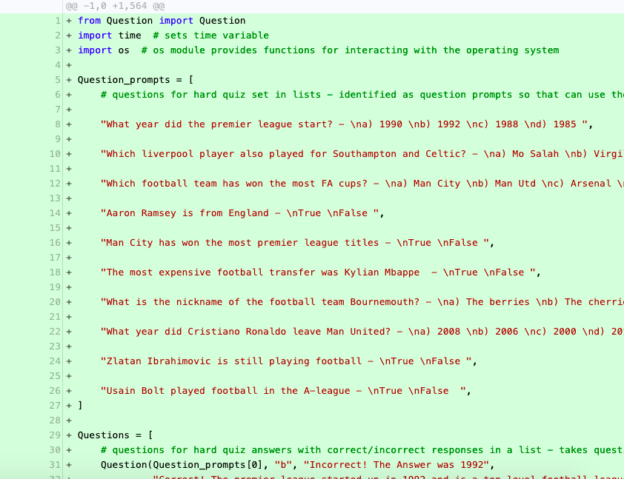
Version control
Through this screenshot it shows the history of my file through repl. The reason at which why repl is not reliable for showing the history of my file because in the screenshot it shows the history of my file from the first day of creating it, what's wrong with the history is that the code shown in the screenshot was not added on the first day of creating the file and was added later, such as the import os code, which was added later on in the development of the code as it was suggested for the quiz to look nicer and for it be easier to read. I don’t know as to why it is showing the incorrect history and is why it was unreliable to get screenshots of repl.it history

Slide 8
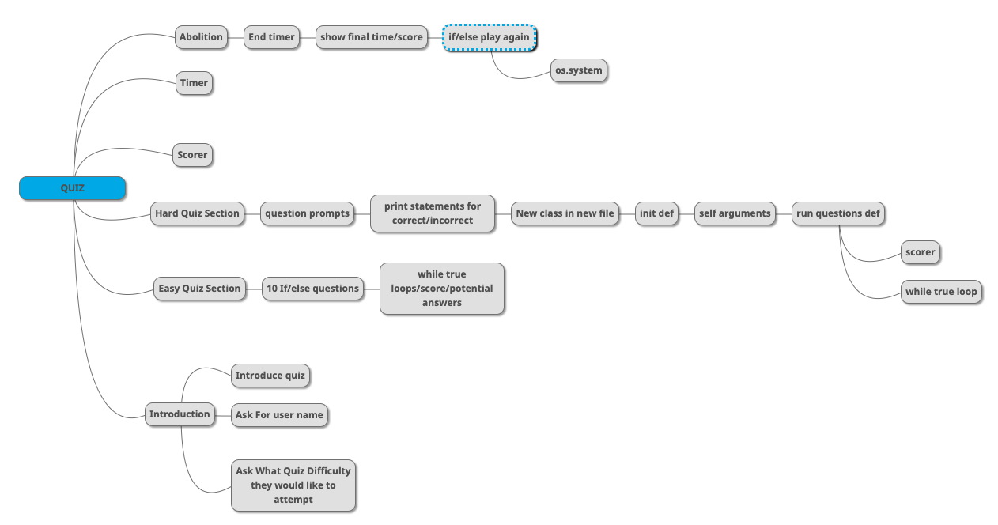
Decomposing outcome
Record evidence that you have broken the outcome into smaller components.

Slide 9
Decomposition
My fully functional quiz consists of many components, these components are what I have coded to join up and complete the quiz. The main sections of my quiz are introduction, easy quiz section, hard quiz section, score recorder, timer, and then the end section which asks the user if they want to play again. Within these sections there are coded statements and functions which are key to the purpose of my quiz.
Users will go through and complete the quiz by providing their name, what difficulty of quiz they would like to attempt, their answers for each questions within the quiz difficulty, and whether they would like to play again or not.

Slide 10
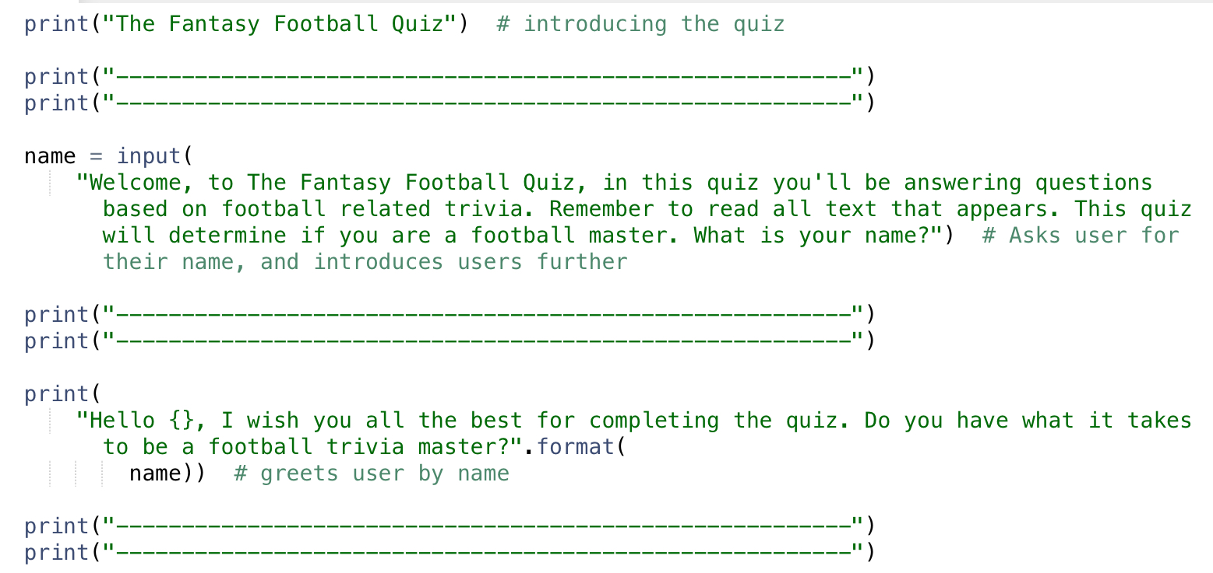
Introduction
For my introduction I first started by introducing the user to the quiz.
The first line of code that was written in this quiz was the print statement “The Fantasy Football Quiz”, this being the title and start of my quiz.
I then asked for the users name with a little backstory to the quiz with a couple of instructions before going ahead with the quiz, I did this by entering a user input (name = input), what this does is it allows users to enter their name at the end of the string and that the name value at the start of the user input (name = input) is what is used to hold the input of the user. This can then be used later (name) to acknowledge user by their name.
The last printed string which consists of the .format is a method which uses the specified value in the bracket(s) in this case is the (name)) value and inserts the users input inside of the strings placeholder. This placeholder is defined through the use of {} brackets.
Throughout code I have used print statements with ‘-’ in them, what this odes is it creates space between text so that the text is easier to read for users

Slide 11
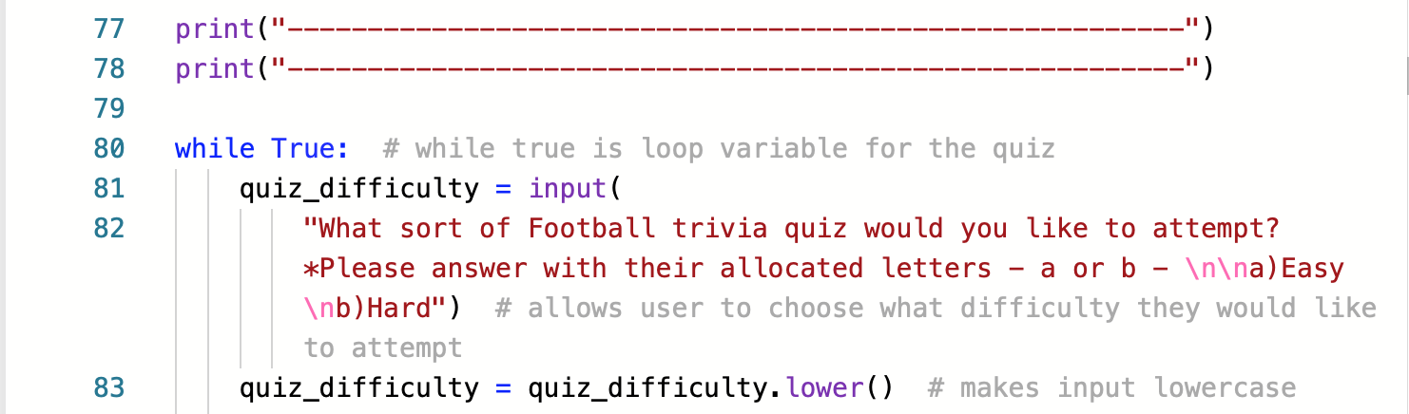
The second part of my introduction consists of code for the users to select which difficulty quiz level they’d like to commence with, this is the start of the main loop shown through the while True: statement. This statement means ‘loop forever’, the while part of the statement uses an expression and executes the loop body whilst the expression is shown in (boolean) ‘True’. The True part of the statement executes the loop body indefinitely. This loop initiates the users flexibility once the quiz is completed and allows the user to restart or try another difficulty of the quiz.
The first bit of code within the while True loop is another user input. This time with the value quiz_difficulty. What this user input does is it allows the user to choose which difficulty of a football quiz they would like to go ahead and attempt. Within the user input it also prints text letting the user know that they can either enter a or b, a being for easy and b being for hard. For the users to read the text easier I also used the \n command which represents a new line, so \n represents one new line. For the final part of this section of the code I also put in a command which automatically lowercases the users input, so if they were to type in A to complete the easy quiz it would automatically change to a. This is seen through the code ‘quiz_difficulty = quiz_difficulty.lower(). This uses the quiz_diffuculty value from the user input and makes the user input lower using the .lower() method.

Slide 12
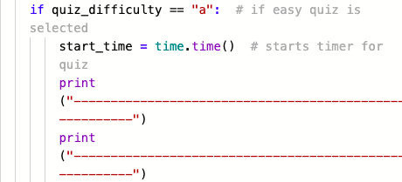
Easy Quiz Section
The first line of code within my python quiz that is relevant to the easy quiz section is this (import time), ‘time’ is a module used to handle time related tasks within the quiz, what I was expecting from importing this was to record the time in which it took respondents to complete the quiz. What the import value does is it imports the initial time module into the code allowing for further use and manipulation of the module.
For the next part related to the easy section is for the users to select the easy question. The first line of code above uses the value quiz_difficulty in an if statement, which is a decision making statement that provides directions for the code to follow to make certain decisions based on particular criteria. In this case it is providing directions to initiate the easy quiz section if “a” is entered by the user in a previous user input line of code. The rest of the code following this IF statement is initiated once “a” is selected. The next line of code is what is used to calculate and express the time taken to complete the quiz (it essentially stores the starting time before the next line of code executes). It is the starting command for the time sequence, once “a” is selected the time for completion will commence. time.time() is used to return the time in seconds and start_time is a value that is used to represent it shown through the ‘=’ operator. Which shows that start_time is equal to time.time(), so once start_time is used again it will represent time.time().

Slide 13
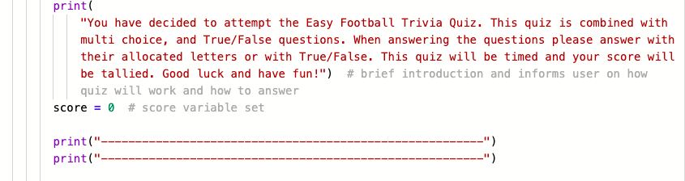
These next couple lines of code are used after the time has started, first there is a print statement which lets the user know that they have selected the easy quiz and that the quiz is combined with multi choice and true/false questions, and gives instructions as well as informants in regards to completing the quiz.
For the second line of code (score = 0), this is what initiates the score variable which will be used throughout the easy quiz section.

Slide 14
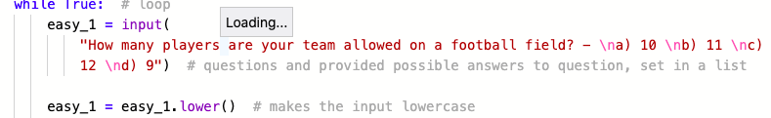
Multi-Choice Easy quiz question
Within my easy quiz section there are 10 questions, half being multi choice and the other half being true/false questions, therefore for the purpose of me not repeating myself I will only being showing the decomposition of 1 question of both a true/false and multi choice question.
For the multi choice questions they start with a set up of a while True: loop, this is because it enables users to attempt the question again if they enter an input that is not relevant to the possible options given.
The second line of code is a user input which provides the possible options for the question that has been asked, each possible answer is put onto a new line using the \n command so that it is easier for users to read what answers they have to choose from.
For the last line of code within this screenshot again uses the .lower() method which makes the user input lowercase so if they were to put A as their answer, the capitalism on the A would then be read as a lowercase. This is done so that less unnecessary code would have to be written.

Slide 15
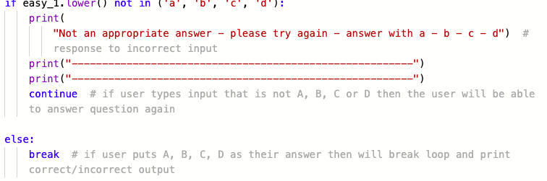
For the next section of the multi choice questions uses if and else statements. For the IF statement, it is providing directions to the user input to print a statement if the user inputs an answer to the question which is not one of the given potential answers. These potential answers that the user is able to use as an input is a,b,c,d, and if the user inputs anything else a print statement will print and take action, which will be directional based, letting the user know that that only values that they can enter is a,b,c,d. If the user puts in a value that is not of the potential options a continue statement will also be printed, what this does is it instructs the while True loop in the previous slide to continue to the next iteration (note* any code that follows a continue statement will not be executed), in this case the next iteration is to repeat the question again.
However if users put in an acceptable answer whether it be wrong or right, there will be an else statement which will break the loop as the user does not need to repeat the questions as they have answer with one of the answers given (a,b,c,d)

Slide 16
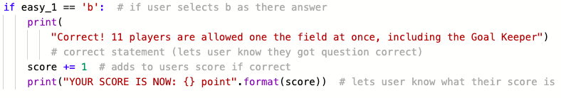
The next section of the multi choice questions is printing the sequence which occurs when the user gets the answer to question correct. It first begins with an IF statement which is providing directions to the code to print a print statement is the user input (easy_1) is equal to ‘b’ which is the correct answer to the question. This print statement will let the user know that the got the question correct and will provide a little more context behind the question and answer.
Once this print statement is executed 1 point will add to the users score (score += 1) and another print statement will execute which again uses the .format method which uses the specified value of score in () brackets and inserts the users score inside of the strings placeholder {}. This allows the user to see what their score is throughout the quiz.

Slide 17
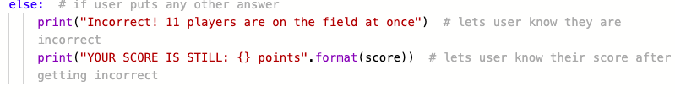
The last section of each multi choice question is an else statement following the IF statement in the previous slide. This statement prints 2 different print statements which once executed lets the user know that they got the question incorrect and again gives the user their score using the .format method. The else statement reads any user input that is within the appropriate answers (a,b,c,d) that are incorrect, so if the answer is B and the user puts in either A,C,D, then the else statement will be executed.

Slide 18
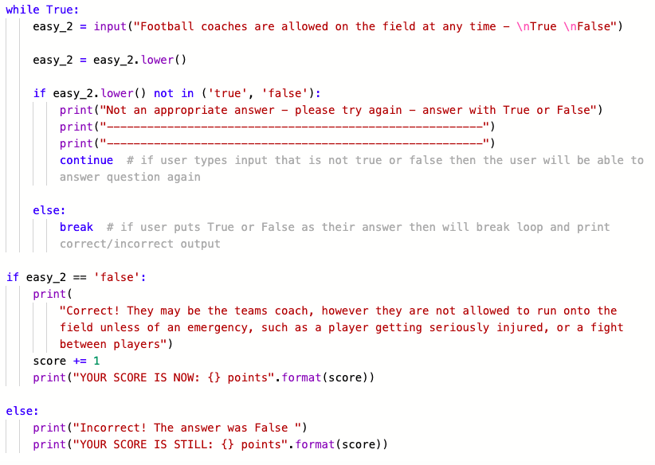
True/False Easy quiz question
For the true/false questions within the easy quiz sections, they are set up the same way in which the multi choice questions are, the only difference with the true/false questions is that the user input can only either be true or false otherwise the while True loop will reset through the ‘continue’ command. This means that the potential answers that are showed on new lines instead of a,b,c,d will be true and false.
For each question the print statements will also be different as there will be different contexts for the different questions.

Slide 19
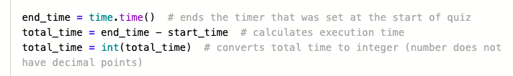
End of easy quiz - Time, Score, Play Again
Once the user has completed all 10 questions of the quiz the first initiation that will occur is that the time will stop and be recorded. For the the first line of code above this is a function in which ends the timer allowing for the final number incl decimal points to be gathered, it also allows me to set a value for the end time to then be used to calculate the execution time, the end_time value stores the ending time after the final line of code has been executed in the quiz, this would be after the final else statement which prints the users score . The next line of code is what calculates the execution time and uses the two time.time() values to create a new variable (total_time) which holds the lasting execution time, which is calculated by the different between the end_time and start_time variables shown as end_time - start_time. The final line of code above shows the final execution time which is being stored in the total_time value being turned into an integer, what this does is prints the users score as a rounded whole number rather than a number with lots of following decimal points, the reason I did this is because of the aesthetics behind looking at the number, rather than a messy number, users would much prefer just the whole number by itself.

Slide 20
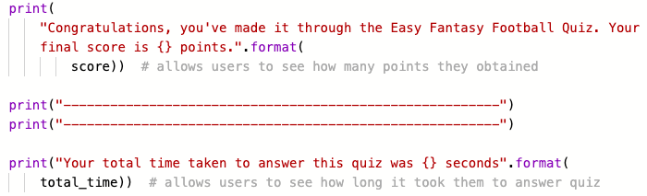
After the final execution time has been calculated it is then shown to the user by using a print statement. As well as the time the final score of the user will also by shown using a print statement. Both use the .format() method, where the specified values for both are score and total_time in the () brackets. Where the time shown as a whole number and the score representing how many questions the user got correct in the quiz are shown in the strings placeholders {} within the print statements.

Slide 21

Once the score and total time it took the user to complete the quiz is shown in a print statement, another print statement will be shown in regards what score the user got, congratulating them on what they got. These print statements are used through if, elif, and else statements.
The code above shows a print statement that would be shown if the user got 10/10. The if statement is giving directions to the print statement to print if the score value at the end of the easy quiz is either 10 or more (>= 10).

Slide 22

Next is an elif statement which is providing directions to the print statement to print if the score value is valued at 9, 5, or any numbers between those two.
Next is another elif statement which is providing directions to the print statement to print if the score value is valued at 4, 2, or any numbers between the two, which would be 3.
The finale statement within this score sequence is an else statement, this is giving directions to the print statement to print if the score value is anything other than the following scores above, this would be 1 or 0.

Slide 23
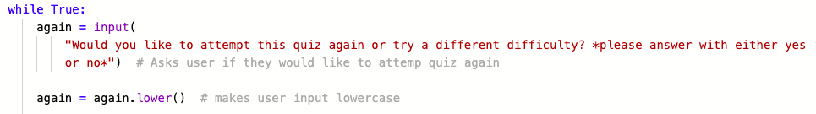
For the final sequence of the easy quiz section is asking the user if they would like to attempt the quiz again or attempt the other difficulty (hard).
This involved me using another while True loop for the user input. Again this only allows the user to put in one of the provided options (yes or no) otherwise if they try to type anything else as their input the loop will take effect and will re ask the user input question.
I also added another factor which makes the users input become lowercase to reduce the amount of code needed.

Slide 24
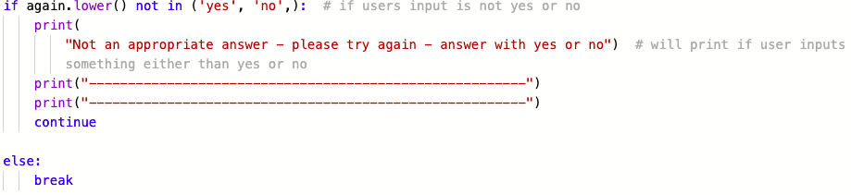
This next section of code follows the while True loop and provides the viable options for the users to choose from in regards to their input (yes, no) using if and else statements. It states that if the users input which is being held in the again.lower() value is not yes or no it will print that print statement following the code above and the continue statement will execute and the question will be re asked.
Otherwise the else statement will pick up the input (yes, no) and will break the loop using the break function.

Slide 25
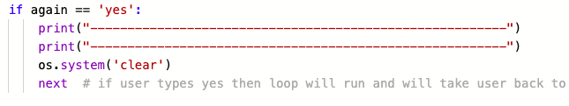
Once the while true loop breaks from the previous slide, another if and else statement will be used to determine how the code should function depending on the user input whether it be yes or no.
The code above shows what would happen if the user said yes to playing the quiz again or trying another difficulty.
Firstly I had to import the os module which helps by providing functions for interacting with the operating system (allows for previous code to be cleared off the screen)
The if statement is giving directions to the again value which would be based off if the user said yes for their input to repeat the initial while True loop which was inserted before choosing the quiz difficulty this allows the user to attempt the quiz again or choose a different difficulty. The ‘next’ statement is used to do this. I have also inserted the os.system(‘clear’) command, what this does is it removes all the previous code from the the users previous attempt of the quiz, the reason I did this is because it allows the user to clearly read what they're doing in their new attempt of the quiz.

Slide 26
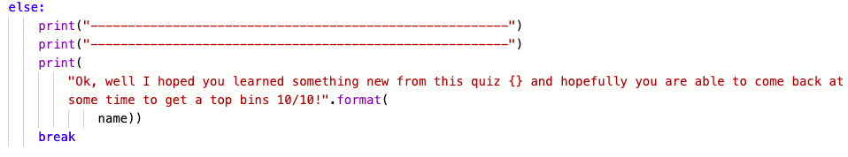
The code above shows what would happen if the user said no to playing the quiz again or trying another difficulty.
Through this else statement it is providing directions for the print statement to print through the .format() method and for the while True loop to break (this would cause the whole code to end) which is the while True loop which was initiated before the quiz difficulty was chosen.

Slide 27
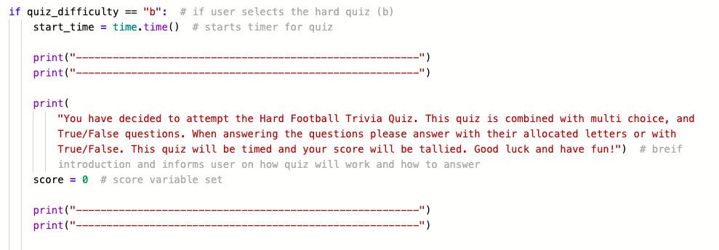
Hard Quiz Section
For the start of the hard quiz section, it follows the same structure and layout as the easy quiz section

Slide 28

Hard Section Questions
For the hard quiz questions, I have structured them differently to the easy quiz questions. For the hard section I have made lists for both the questions with the answers providing context behind the questions and the potential answers to the questions. I have made these separate to structure the questions successfully. Starting with the hard quiz questions I made a new file to hold a class named question. Doing this allowed for the class to be read properly in the main code.
Within this class is a def function which in the end supports my questions which will be shown in a later slide.

Slide 29
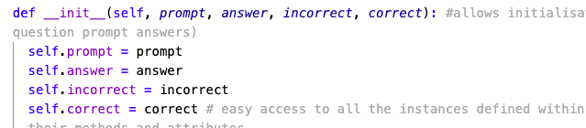
This is the def function which is inside the Question class.
The first line of code in this screenshot which first defines the function uses the reserved method of __init__ and is used as a constructor in object oriented concepts. It allows the class to initialize the attributes of the questions, in this case the attributes are, prompt, answer, incorrect, and correct. These represent the Question, the answer to the question, the incorrect statement that would be printed if the user gets the question wrong, and the correct statement that would be printed if the user gets the question right. Self in this case is not a attribute and instead represents the instance of the class, using self allows me to access the attributes of the class within my main python file.
The next couple lines of code are used to bind the attributes with given arguments, which can be used as values in the main python file.

Slide 30
Above shows the code that I used to import the question class from the python file named Question allowing for the self arguments to be read as values in the main file

Slide 31

Hard question prompts
I then started setting up the questions in a long list using Question _prompts as their value (what the questions are being held in)
The multi choice questions are laid out like this, both the multi choice question prompts and true/false questions prompts follow the same structure as the easy quiz questions.
The true/false questions are laid out like this

Slide 32
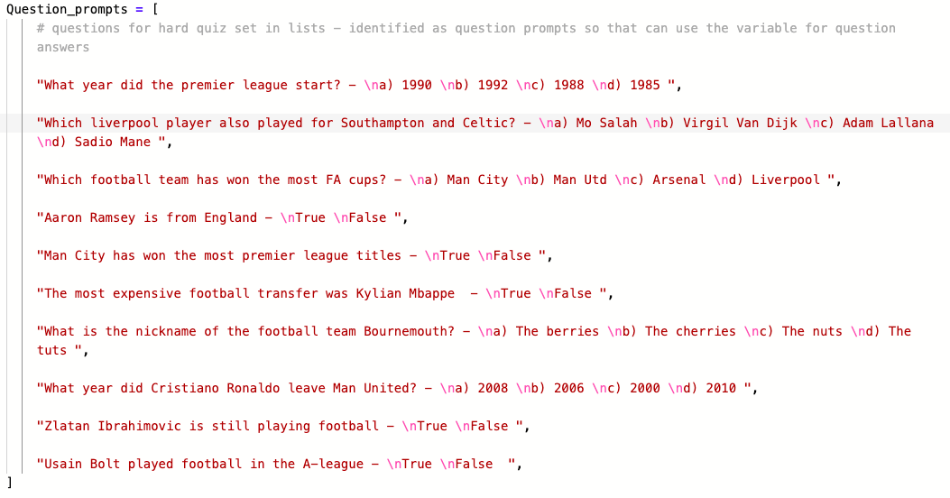
Long list looks like this, indicated through the commas used and the end of each question prompt (,)

Slide 33
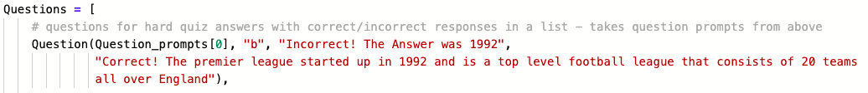
The next part of coding the hard section questions involves is joining the question prompts (described in the previous slides) with the following code above which shows the correct answer, the incorrect statement, and the correct statement, this follows the order of the attribute initialization in the question python file which consists of the ‘self’ instances, with everything being in a list.
The structure of the code above is the same for the other 9 questions, except for the question prompt number shown as green [0]. This number represents the sequence in which the questions will be asked to the user.

Slide 34
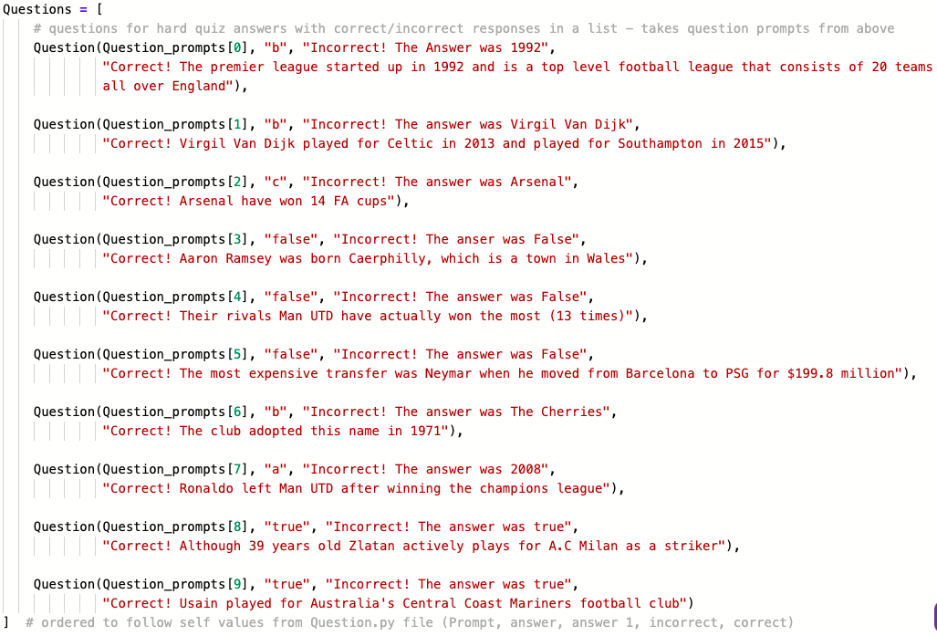

Slide 35
The next part of code relating to the hard quiz questions involves setting another def function for the questions, within this function I used the values from the self arguments from the other python file to set up user input and the users score.
For setting up the score I had to set a global score, this is because I would not be able to tally the score outside the function if I hadn't (global score makes the score variable available outside of the function). The next line of code sets the users score to 0, also setting the score variable which will be used to tally the users score throughout the hard quiz.
The next line of code allows me to manipulate the code for the questions and their attributes in the previous slide

Slide 36
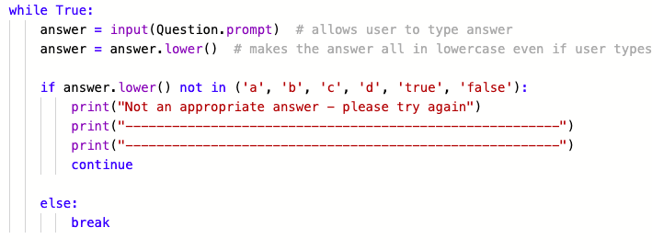
The next section of code is the manipulation of the questions.
It starts off with a while True loop again for user to enter correct input in. The next lines of code take each question prompt and allow it so the user can type their answer, and make it so that their input is lowercase.
Then for the if statement it is giving directions to answer.lower() which is holding the users input to follow the continue statement if the user input is not one of the following values (a,b,c,d,true,false), otherwise if it is it will follow the else statement directions and break the loop as an appropriate answer has been given

Slide 37
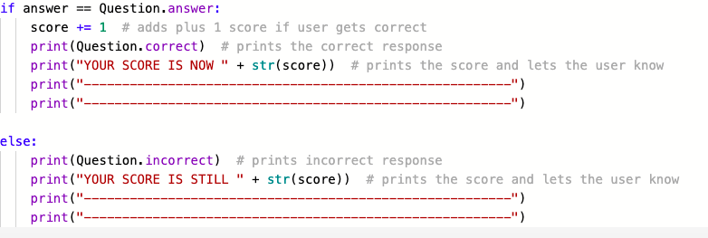
After the while True loop has been broken, it then comes to this code which is another set of if and else statements. For the if statement it is giving directions to the answer variable to add 1 point to the users score if the answers for each question asked in the hard section are one of the acceptable answers in its range (a,b,c,d,true,false). It will then also activate two print statements. One which prints the correct statement for the particular question prompt and the other printing the users score showing how many points the user is on after getting a question correct.
However if the user gets the question incorrect but chooses one of the acceptable options the else statement will take affect, and what it does is it prints the incorrect statement for that particular question prompt and then prints the users score not adding anything to it.

Slide 38
Rest of Hard Quiz Section
For the rest of the hard quiz section it follows the exact same structure as the easy quiz section so don’t need to repeat myself, all print statements are the same, the score and time are all finalised and recorded the same and the user has the same ability to choose whether they want to play that quiz again or choose a different difficulty (easy).

Slide 39
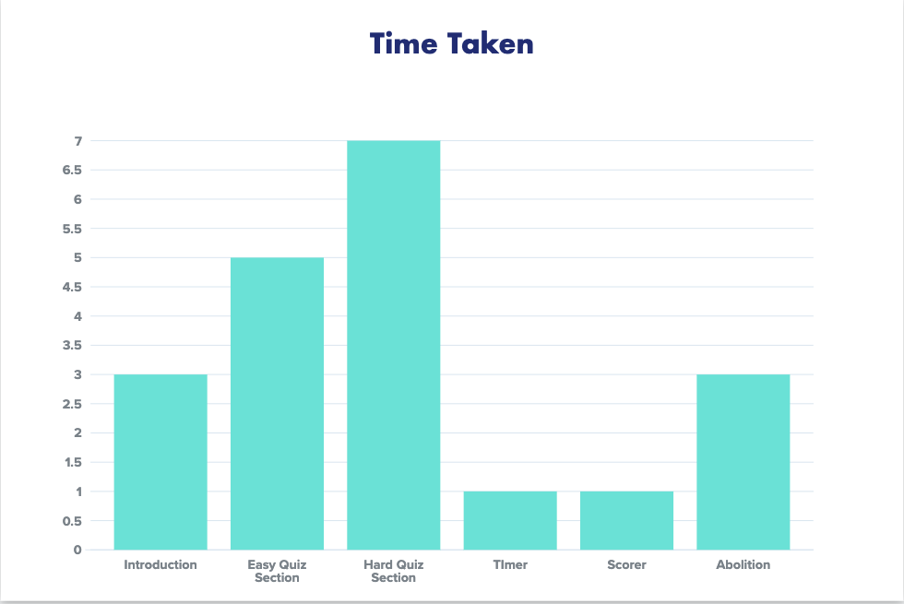
Time Sizing graph for Decomposition Components
Vertical axis is time take in days, horizontal axis are the components within quiz

Slide 40
Trialling components
Record evidence that you have trialled components. Show that you gathered information to inform your decision making.
Record evidence that you have trialled multiple components and have selected those most suitable.
Record evidence that you have used information from trialling appropriately to improve the functionality of the outcome.

Slide 41
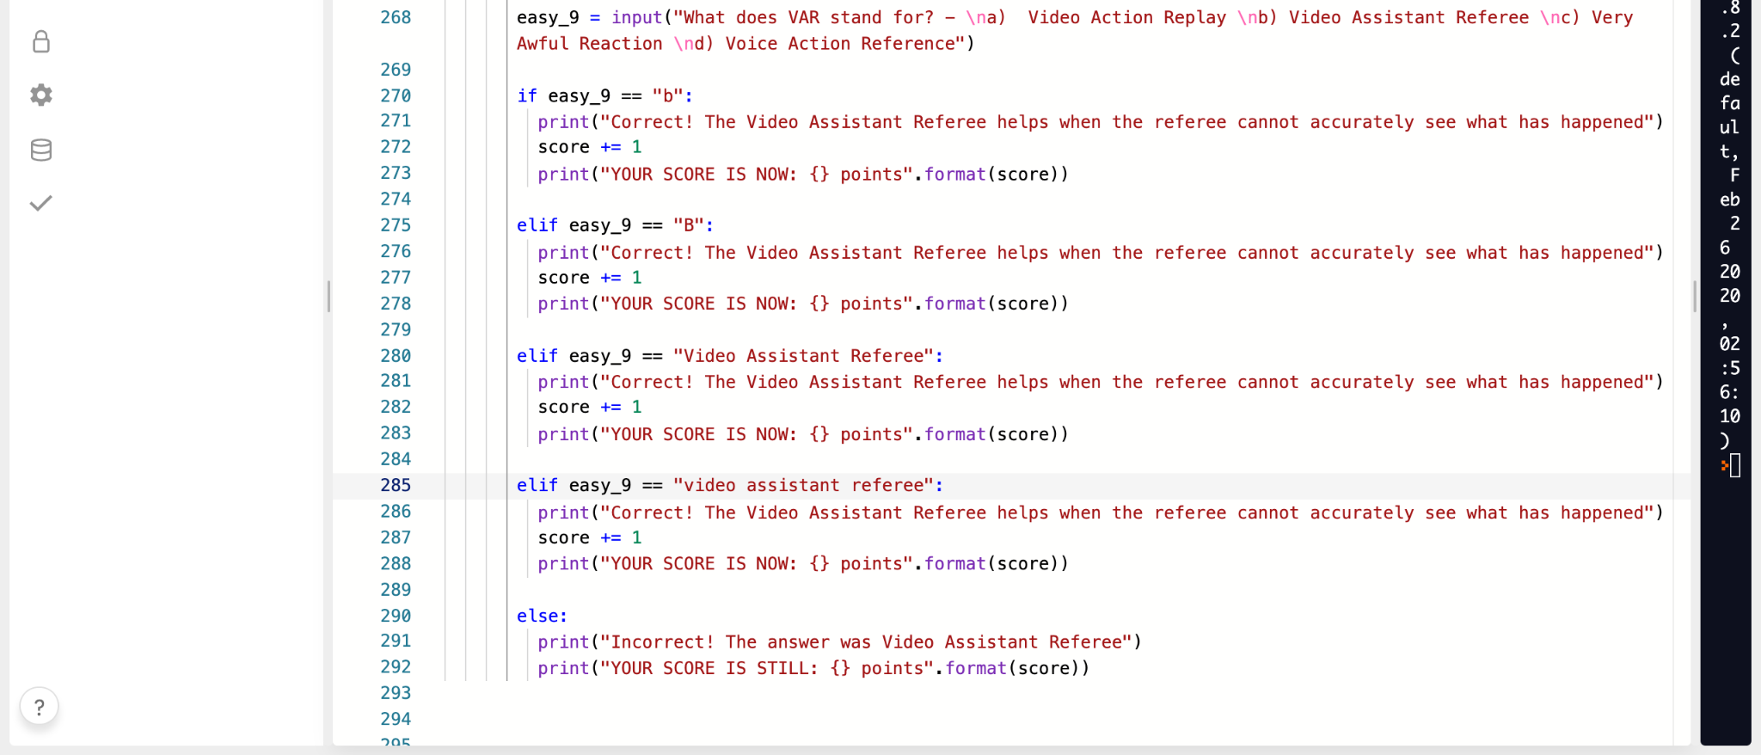
Trialling Component #1- Before

Slide 42
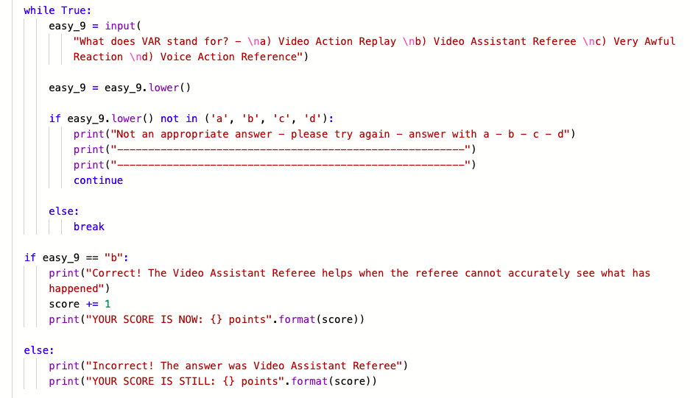
Trialling Component #1 - After

Slide 43
Trialling Component #1 Explained
The first component at which I trialled in my code was each question for the easy quiz section. When I first started coding these questions it required a load of coding as I had to code for each predicted answer a user would put in. In the case for the screenshots above I took screenshots of the 9th easy section question out of the 10 for representation. But in the case of the 9th question I predicted that users would either put in b, B , or the written out correct answer. However doing this was very unreliable and meant that if the user mistakenly got the answer wrong they would still get the answer to the question incorrect. So for error handling I changed the code to make it so that they user could only get the answer incorrect if they put in an incorrect acceptable input response. So for the case of question 9 the user had the acceptable options of A,B,C,D, meaning that they could only put in one of those options to continue through the quiz. Doing this meant that firstly the amount of code written would dramatically decrease making it easier to read for me and it also allows users to have a more enjoyable experience as if they mistakenly got an answer wrong by accidently typing after their answer they wouldn’t be happy that they still got the answer incorrect. This gives users the opportunity to fix their typing mistake whether if they knew the answer or not.

Slide 44
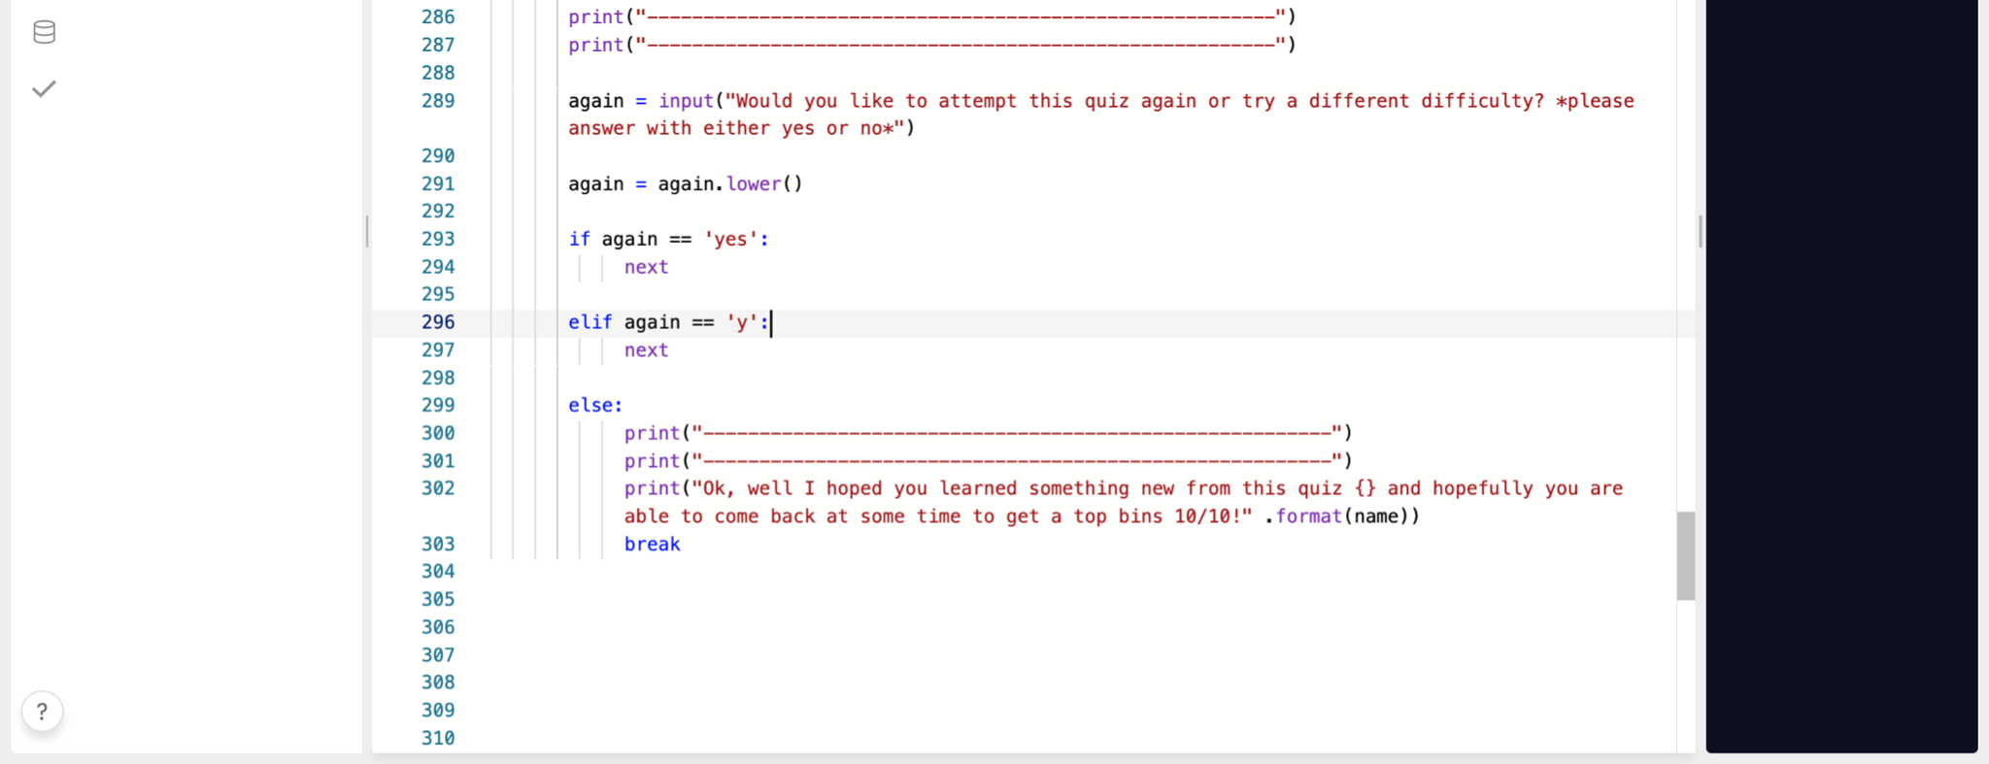
Trialling Component #2 - before

Slide 45
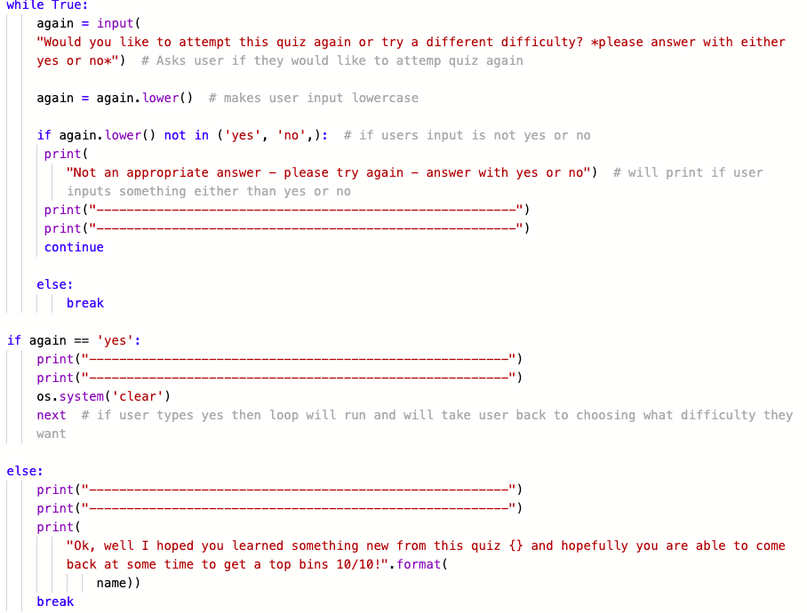
Trialling Component #2 - After

Slide 46
Trialling Component #2 - Explained
The second component at which I trialled in my code was the play again loop. Shown in the screenshots above I improved that section dramatically. Firstly before making changes, I again had to make predictions in regards to what the user would say for if they wanted to play again or not, my assumption was that they would either only say yes or no but didn’t take into consideration whether they would type anything else or if they would accidentally miss click on whatever they were typing on. So I only had code for if the user said yes to continue the loop and that if they typed anything else the quiz would stop and the code would break. So I trialled and made the same change I did as the easy quiz section where I made it so that the user could only put in two possible answers for the quiz to continue and make its next move, these possible answers were yes, no. Another component at which I trialled was the os.system function. Previously when the user said yes, that they wanted to attempt the quiz again or try another difficulty all their previous code would be present, so by me adding the os.system module it removed all of this previous text from the users last attempt at the quiz. What this did is it made it so that the following text after the last users attempt would be easy to read allowing for better functionality of the quiz.

Slide 47
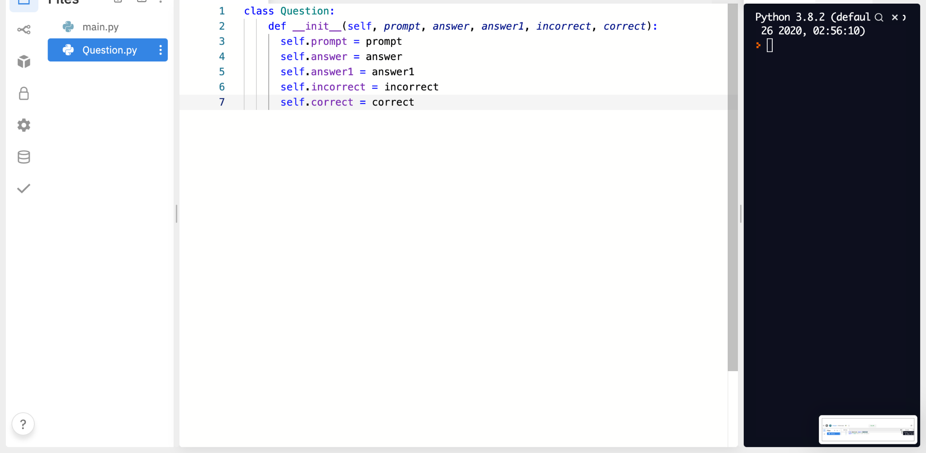
Trialling Component #3 - Before

Slide 48
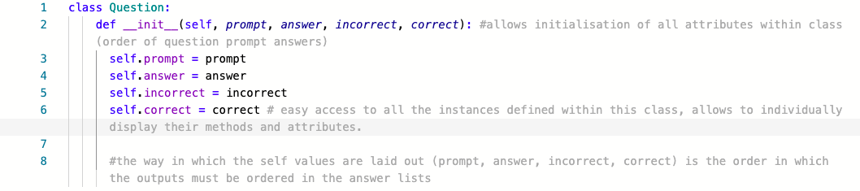
Trialling Component #3- After

Slide 49
Trialling Component #3 - Explained
The third component at which I trialled in my code was my question class which is in the other python file within my project. In the before screenshot I had an answer 1 argument, however after trialling I realised that I didn’t need that specific argument and seen in the after screenshot I have it removed as well as in the init def brackets. This change again follows the same method I used for the easy quiz section and the play again section where the user only was only able to put in one acceptable answer. Removing answer 1 meant that the user only had 1 potential answer to put in to get the question correct as there was another answer argument where that correlates to either A,B,C,D or True,False depending on what question the users answer. The answer 1 correlated to a text response where the user types in the whole answer rather than the letter that stood for it. Doing this meant that again the user wouldn't get the correct answer mistakenly wrong and it also meant that more code would be able to be removed from the python file.

Slide 50
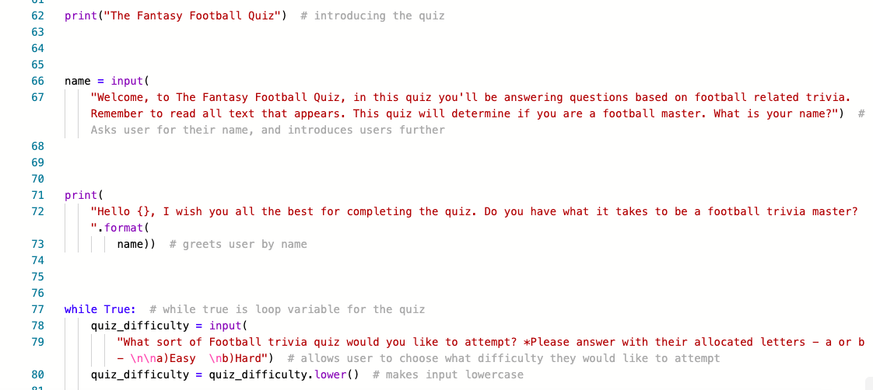
Trialling Component #4 - before

Slide 51
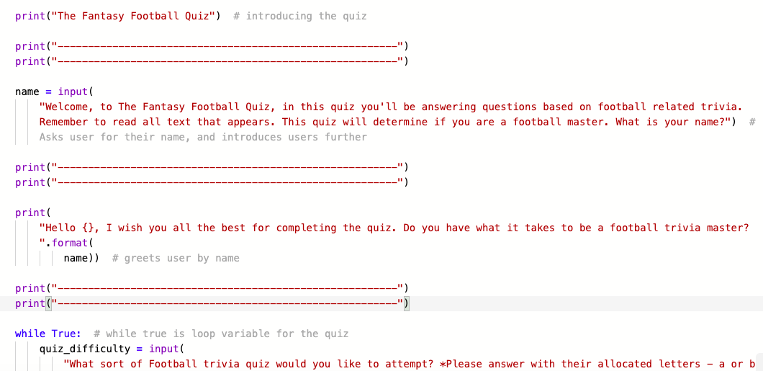
Trialling Component #4 - After

Slide 52
Trialling Component #4 - Explained
For the fourth component at which I trialled in my code was the ‘-’ print statements throughout my code. In the after screenshot above it shows what the start of my code was like without the ‘-’ print statements. Adding these were very beneficial to my quiz as it meant that there was significant spacing between text and questions that were displaying in the output. Having this spacing meant that a lot of the text was much easier to read and correspond, allowing for users to be able to use the quiz without any issue. It especially helps those who have seeing problems as it meant that they would be able to make out each bit of text completely fine without the worry of not being able to read any of it due to it all being combined together.

Slide 53
Testing outcome
Record evidence that you have tested your outcome.
Explain how the testing made sure your outcome functions as intended to meet its purpose and requirements.
Record evidence that you have used information from testing appropriately to improve the functionality of the outcome.

Slide 54
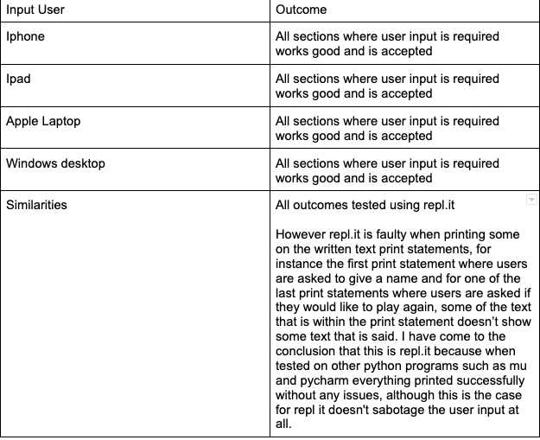
Testing outcomes

Slide 55
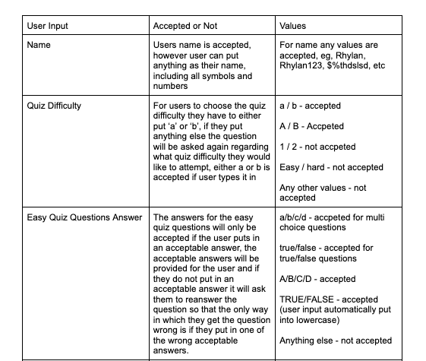
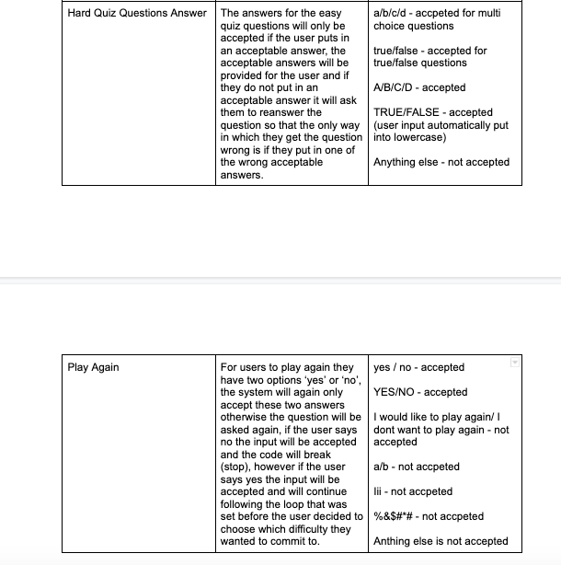

Slide 56

Apple Laptop

Slide 57
Iphone

Slide 58
Ipad

Slide 59
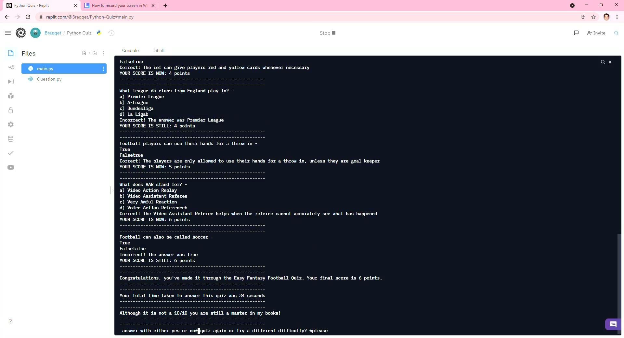
Windows Desktop

Slide 60
Testing outcomes explained
The reason at which I tested the quiz through repl.it on multiple devices was because for reliability and validity. In order for all users to use the quiz I tested the outcome of my quiz on 4 different devices, iphone, ipad, laptop and desktop. Doing this meant that I was able to see that the intended outcome of my quiz was able to be approached and successful on all devices as users may attempt the quiz on any device. Do this also meant that I could check similarities, such as common errors and etc, it also meant that I could see singular errors that may occur on one deceive and no the other. However after thorough testing on all devices I can conclude that each device’s outcome of the quiz is successful, the only common error that occurs on all of the devices is that some of the longer text statements don’t appear. Such as the first statement where it asks for the users name, I can’t come to a conclusion as to why this may be, but all I can say is that it is an error through repl.it and not my code, this is because firstly I tested my code on my home desktop on other python programs such as pycharm and the code prints successfully on their and secondly I put my code into pep8 which is a python checker, which checks the code for errors and improper functions. Both had given me good results in regards to this problem however, repl.it for some reason does not work, and as I was unable to use a personal device to build and create my quiz, repl.it was the only option as it meant that I would be able to access the code on other devices rather than the schools.

Slide 61
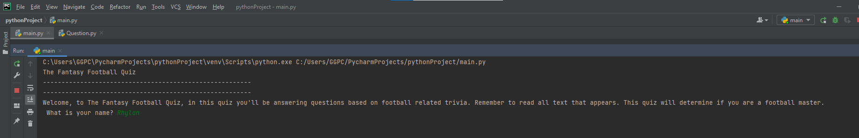
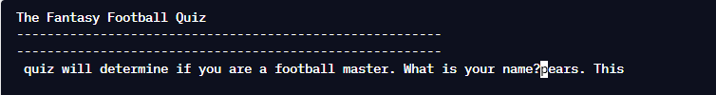
Comparison
Pycharm
Repl.it

Slide 62
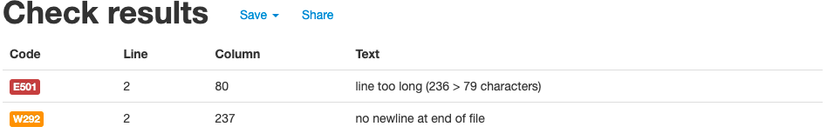
Pep8
After putting the specific line of code (users name input) into pep8 for testing the only error there was that the line was too long, however, further in my quiz I have another print statement which is longer the the users name input line, and that prints fine through repl.it, this confused me and is why I am not very conclusive as to why this specific line of code does not print successfully though repl

Slide 63
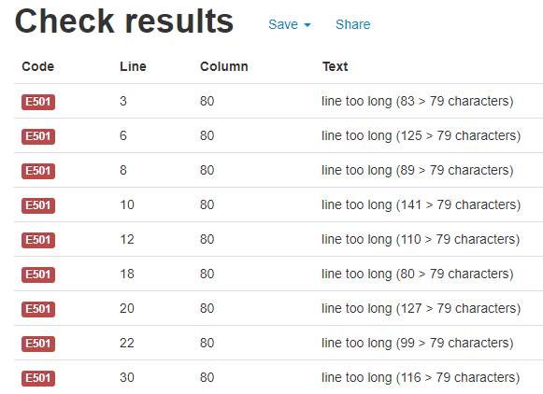
Pep8 Further explained
Throughout testing my code I used pep8 to help improve the appearance and structure of my quiz. It helped me fix errors and noticeable mistakes, however due to these mistakes being slim there was no real improvement towards my code, most of the errors that occurred were just that most of my print statements which contained text were too long, however this didn’t affect my code printing at all as everything apart from a few print statements such as users name input are bugged and affected through repl.
When checking my code through PEP8 these are the only errors that occur and some occasional indentation errors which do not affect my code.

Slide 64
Relevant Implications
Explain the relevant implications here. Explain the Implications that are relevant to your outcome.
Record evidence that you have addressed the Implications that are relevant to your outcome.

Slide 65


Implication 1- Cultural
An implication that my quiz will be following is the Cultural implication. The cultural implication follows the mental acceptance, social forms, and reinforced traits of a variety of religious, racial and social communities. This implication ensures that the outcome of my quiz is inclusive and does not contain any content that may offend or threaten a certain culture.
I have decided to use this implication within my quiz so that there will be no racial or prejudice information that will be present in my quiz, potentially found within the quiz questions or print statements that hold responses. I have also decided to follow through with this implication because doing so will ensure that my python quiz will get no complaints from those users who may get offended in any way by the projected information that they will be reading whilst completing the quiz. Receiving complaints from the users who attempt my python quiz would likely result in back lash and bad reviews which means that others will likely be influenced by what others have been saying about the quiz which could potentially result in no one wanting to attempt the quiz. A way in which I have followed through with this implication is by making sure that I get all names of football players or countries spelt correctly.
My python quiz will be using this implication

Slide 66
Implication 2 - Usability
Another implication that my quiz will be following is the usability implication. This implication is used to measure how well a particular user in a specific context can use and operate a certain product/design in order to achieve a defined outcome effectively, efficiently and satisfactorily. This implication ensures that users are able to complete and navigate through my quiz efficiently without any issues.
I have decided to use this implication within my quiz so that all users who may attempt my quiz are able to do so without any issues or problems in regards to navigating through the quiz. It will allow people of all ages (who are old enough to have the authority on a device) to access and navigate my quiz with ease. Instances in my quiz where I have followed this implication is firstly when I added print statements with ‘-’ in them. I added these print statements after each print statement which consisted of some form of dialogue, doing this split each bit of text allowing for users to read each text paragraph with ease. Another instance in which I followed through with this implication was when I provided the potential answers for the questions. What I did was put each potential answer on a new line using the \n command, doing this allows the users to easily each potential answer so that they do not mistake other text for a potential answer.

Slide 67
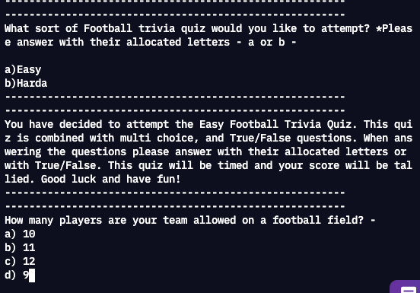
Usability Evidence

Slide 68
Implication 3 - Aesthetics
Another implication that my quiz will be following is the aesthetics implication. This implication is used to measure the attractiveness of an outcome. It is usually put in place for users to enjoy their experience if they were to use the particular outcome, regarding the prettiness and if it looks good. This implication ensures that users find my quiz good looking allowing for an enjoyable experience.
I have decided to use this implication within my quiz so that when users go through and attempt the quiz they enjoy going through it more based on the scheme and layout of the quiz and how the overall text and questions are proposed to them. It will allow users to become more eager on going through the quiz knowing that their experience will be more enjoyable as the layout/colours and etc all look appealing. Although in my quiz I am unable to change the colours of the text and background I feel as if the colour scheme that I have equipt is good looking, it also allows for users to read the text a lot easier (black background, with white text). Instances in my quiz when I have followed through with this implication is firstly again when I used the ‘-’ print statements to add lines between the text, this made the quiz look more intriguing and a lot easier to read, another instance is when I used the os.system function which removes previous code if users attempt to try another quiz or the same quiz again. Do this made the quiz look a lot cleaner and again easier to understand and read.

Slide 69
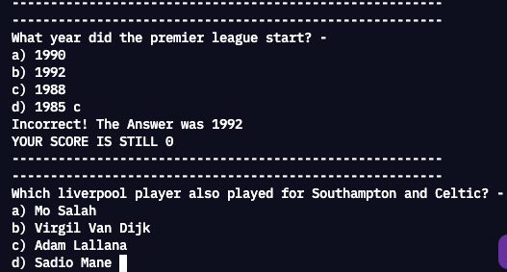
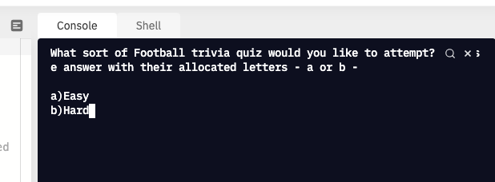
Aesthetics Evidence
Shows previous code is cleared once user decides to choose another quiz difficulty or attempt the same quiz again because of the os.system function
Shows the ‘-’ print statements

Slide 70
Implication 4 - Functionality
Another implication that my quiz will be following is the functionality implication. This implication is used to measure the state of the outcome and how useful it is. It measures if the outcome follows users expectations, if anyone can use the outcome, and if people know how to use it. This implication ensures that everything in the quiz is working to expectations so that users will not have a hard time completing the final expectation of the outcome.
I have decided to use this implication within my quiz so that when users attempt my quiz they can do so without any problems regarding coding errors or confusion which may deny them from further completing the quiz. Having coding errors may also potentially confuse them leading to unhappy users as people who attempt quizzes usually want to have fun doing so, and having a quiz that has high chances of having bugs would not be eventful for the users. An instance in my quiz when I have followed through with this implication is when I have provided instructions to users on what they are expected to find during the completion of the quiz and how to answer particular questions and etc. Providing these instructions means that users would not be confused in any instance during the quiz allowing for their experience to be more enjoyable, and as the instructions are clear they are easy to understand by everyone.

Slide 71
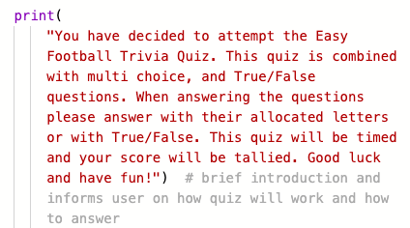
Functionality evidence
Print statement for the easy football quiz section which provides information and instructions regarding answering the questions and what sort of questions the users will be encountering.

Slide 72
Evaluate
Discuss how the information from planning, testing and trialling of components assisted in the development of a high-quality outcome.

Slide 73
Planning - Evaluation
This part of my project allowed me to see how much time I had available to complete each task and what had to be done.
For planning my time through this project I used trello, after the constant change in which time management tool I would use trello was the final decision. This helped and showed me how much time I had available to complete each task and checkpoint. As a result from using this time management tool, I didn’t run out of time when it came to completing my quiz which allowed me to hand in a completed and successful project/outcome.
Want went well with planning is that trello allowed me to set reminders and time bound periods which meant that I was able to get notifications as to when a checkpoint or section of my quiz had to be completed or must be completed by, trello also allowed me to mark off a checkpoint once completed which allowed me to have a good idea on the progress that I had made.
What didn’t go well is the time it took to choose the specific time management tool, this killed a lot of my time and meant that for the time at which I didn’t have a specific time bound period for certain sections of my quiz I wasn't too sure whether I was behind, infront or on schedule with what I was expecting to complete.
What I would do differently next time with planning is that I would straight away find a good efficient time management tool which does provide me with the opportunity of adding dates to different checkpoints, this means that I won't be able to waste any time on this and get to coding straight away so that the final deadlines won’t be very tight.
However, overall the planning was very successful and allowed each part of my quiz to be completed at the date in which I set, and in the end allowed my final project outcome to be submitted on time.

Slide 74
Trialling - Evaluation
This allowed me to grasp what in my code needed to be put into place for it to become more efficient, with what worked and what didn’t.
In the end I trialled multiple components within my quiz, and watched multiple other users attempt the quiz to see if there were any errors or mistakes at which needed to be fixed or modified. This allowed me to identify what the quiz looked like from another user's point of view and also allowed me to identify what changes I could make to the quiz to improve its functionality and usability. It allowed me to also be provided with feedback from other users to and fix common requests so that the quiz could appeal to my audience and so that they would be happy to attempt the quiz more and so that they can share it with others.
What went well with trialling is that I was successfully able to be provided with feedback from other users to get take on the quiz. I got 6 people to trial my quiz (mostly friends) and linked common requests from all of them to then fix or add onto my quiz, all of them gave valuable feedback which allowed my quiz to become a lot more appealing and usable.
What didn’t go well was that when personally trialling components within my quiz I didn’t get to taking many screenshots of the outcome of each trial, although I did trial the outcome many times I forgot to take screenshots, this meant that I was unable to show the true comparison of the outcomes, however I was able to show the comparison in code.
What I would do differently for trialling next time is I would make sure to take screenshots of the outcomes when changing a section within my quiz to provide evidence that something has been changed in the outcome. What I would also do differently next time is that I would get others rather than friends to trial my code, and as most of my friends are boys I would've liked to get a girls point of view to see what they thought in regards to the overall appearance and usability of my quiz.
However, overall I got very reliable feedback from trialling which allowed my overall outcome to become more appealing to users.

Slide 75
Testing - Evaluation
This allowed me to see whether my quiz was able to be run on multiple sources (varying devices), and whether the usability of the quiz was successful.
When testing, I tested that all of the quiz displayed and worked fine through repl.it on multiple devices. One key mistake that I kept testing was when a user put in a random answer for each of the user inputs. Through testing I found out that if a user was to put a random answer in then they would get the question automatically incorrect, this would occur on all devices. So I had to go back a fix this key mistake, to handle the problem, fixing this meant that my final quiz would be able to be used more efficiently and meant that users would be more happy with the outcome.
What went well with testing is that my quiz was able to successfully run on all devices meaning that whatever the users use to attempt the quiz on will be acceptable. My quiz on all devices was able to be read and operated equally allowing for more users to attempt the quiz, what was good was that no text errors occurred and that the only errors that did occur were the same on all devices which meant that once fixed it would display on each device.
What didn’t go well with testing was that repl sometimes bugged and didn’t show certain lines of text, such as the starting print statement which asks for the users name. This was a big problem because it does not allow users to read the introductory text which introduces them to the quiz, this wasn't a problem with my code as I put it through pep8 and tested it on other python programs and there was nothing wrong with it so therefore it was the python program I was using, this meant that users would miss key information regarding the quiz and what it was based on.
What I would do differently next time is that I would test the code on other python programs to see which program would be best to use to run the code for users, this means that if one error occurs on one program and not on the other I can use the other which would be more efficient, this would mean that users will be able to soak in all the information required to go through the quiz such as instructions and other key information.
However, overall after testing my program it is able to successfully run otherwise on all devices allowing for a wider range of users to attempt my quiz.

